Slide 1
I Thessalonians
Introduction

Slide 2
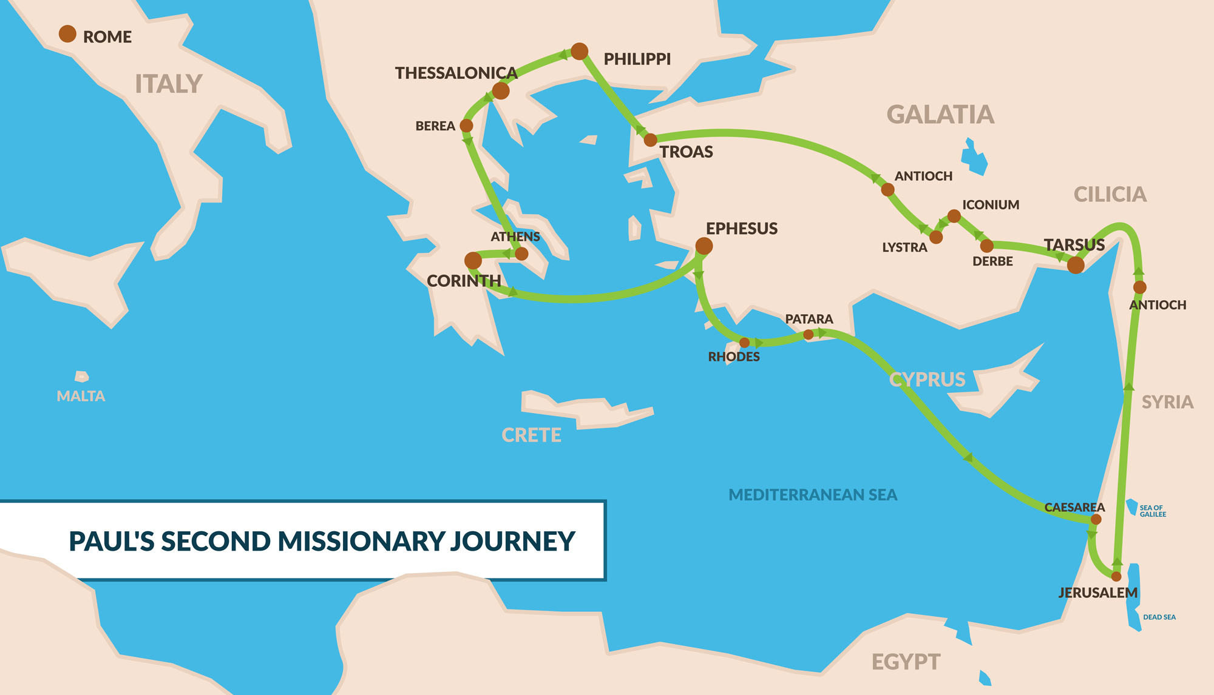

Slide 3
In the 1st Century, Thessalonica was the capital of the province of Macedonia. It’s name previously was “Therma” because of its hot springs. Later, the city was named Thessalonica after the sister of Alexander the Great.
Paul’s main partner while in Thessalonica was Silas who he chosen after his split with Barnabas. In 2 Corinthians 1:19, Paul makes mention of Silas preaching Jesus and later in the New Testament, Silas is associated with Peter and his letter written to the many churches who were dispersed (I Peter 5:12).
We first meet Silas in Acts 15:22 at the Jerusalem council. He was one “of the leading men” that the council chose to circulate a letter that encouraged the Gentiles to remain faithful to their profession of faith and to stand strong against the Judaizers.
In Acts 16, Silas is imprisoned with Paul in Philippi. During the night, while praying and singing hymns, the Lord caused a great earthquake that broke the shackles of Paul, Silas, and the rest of the prisoners and the cell doors were opened.

Slide 4
Acts 17:1-9
Once arriving in Thessalonica, Paul enters the synagogue, which was typical for him. The Apostle did not attend synagogues to worship with the people, but instead, to preach the gospel to them.
After preaching to the Thessalonians for three weeks, many of them became believers including both Jews and Greeks, and men and women.
The key for building a church in Thessalonica was in the fact that the Greeks came to saving faith. Previously, they would visit the synagogue on every Sabbath because they were attracted to the monotheistic worship of the Jews and their morality.
The Jewish community in Thessalonica did not take kindly to losing a considerable amount of their congregation to Paul and this “new” religion. Therefore, they resort to violence, form a mob, and attack the house of Jason who was Paul’s host. The mob drag Jason to trial and charge him with helping those “who turned the world upside down”.
Jason and his household paid a hefty fine and probably agreed it would be best if Paul and his companions left the area.

Slide 5
The authenticity of the Letter. How do we know Paul wrote this letter?
  1. Paul is revealed to the be author and he has with him two common travel companions who are attested in other parts of Scripture to have served with Paul in Thessalonica.
  2. The material in I Thessalonians appears in other “Pauline Letters”. Material such as Paul giving thanks to God for the church, the church’s support for Paul’s ministry, unity and peace, suffering for Christ’s sake, and the coming Kingdom of God.
  3. The early church fathers attest that Paul is the author of this letter. Men like Polycarp( 1st century, disciple of the apostle John), Irenaeus (2nd century church father who quoted frequently from I Thessalonians in his own writings), and Justin Martyr (2nd century) all verified the authenticity of I Thessalonians.
What is the purpose of writing I Thessalonians?
  Paul wrote I Thessalonians as a response to the report that Timothy brought back to Paul (I Thess. 3:6).

Slide 6
What’s in this Letter?
  Paul defends his ministry (I Thess. 2:1-12).
  The Thessalonians were being persecuted by the pagans (I Thess. 2:14).
  Encouragement for the Thessalonians to remain faithful to God while being influenced to return to their easy-going pagan standards (I Thess. 4:4, 5).
  Some members of the church were content living off of other people (I Thess. 4:11).
  To comfort the Thessalonians about the Second Coming (I Thess. 5:1).
  Possible tension between the church leaders and the rest of the congregation (I Thess. 5:12).
  Maybe some concerns about the Holy Spirit and spiritual gifts (I Thess. 5:19).

Slide 7
A typical Pauline greeting
  Our typical greetings to each other are never as elaborate as the greetings in Scripture. Even when we write emails or send text messages to one another, our greetings are always just plain: “Hey, what’s up”? Or, “good morning, how are you”. When Paul writes a letter to the Church his greetings are always exact and profound.
  To the Thessalonians Paul writes, “To the church of the Thessalonians in God the Father and the Lord Jesus Christ: Grace to you and peace”. For a church to hear from an Apostle, especially one with the prestige and popularity as Paul, that they are “in God the Father and the Lord Jesus Christ” has to be really promising. Paul opens up the letter by verifying that the Thessalonians are indeed living the Christian life; they are “in right relationship with God the Father and God the Son”.
  Because the Thessalonians are “in God the Father and the Lord Jesus Christ” Paul pronounces upon the church that the grace and peace of God is with them.
  By extending grace to the church this allows the church to call God “Father” and to acknowledge Jesus as their Lord. Therefore, God’s grace changes our relationship with God and puts us in right standing with God. It is an incredible reality that we can call God “our Father” and we should never take that for granted.
  Not only does grace and peace bind us to God, it binds us to each other. The gospel brings us together as a people of God. For the Thessalonians, this “binding together” means more to them than probably the Philippians. Look back at Acts 17:4. This new church was a mixture of both Jews and Gentiles. When the entire city has turned against you, it’s encouraging to know who is actually with you.

Slide 8
I mentioned during the introduction that the occasion for the letter was a response from Paul to what Timothy had reported to him. In I Thessalonians 3:6, “Now that Timothy has come to us from you, and has brought us the good news of your faith and love and reported that you always remember us kindly and long to see us”.
Therefore, Paul begins this letter by giving thanks to God for the work that the Lord has been doing among the Thessalonians.
  Paul mentions the Thessalonian’s “work of faith”. Obviously Paul is not talking about “work” as in man’s power to be accepted by God. What Paul means here is the response to the work of the Holy Spirit in us. In v. 9, Paul is specific concerning the work that the Thessalonians are doing. Look at v. 9. Their faith has produced fruit. They turned from idols to serve the living God. The work of the Holy Spirit persuades us to leave our former life behind (serving idols) and to begin to serve and obey God. This is Sanctification 101; the very first step. As long as we are slaves to sin, righteousness will never be our master. And this kind of “work of faith” is evident in the lives of the Thessalonians.
  Secondly, Paul is thankful for “their labor of love”. The objects of this love were the members of the local church (1:3), the leadership of the church (5:3), other churches in Macedonia (4:9), and to many other places (1:8).
  Lastly, Paul is thankful for their “steadfastness in hope”. This is the kind of endurance that happens as we experience many trials and afflictions. Although the church in Thessalonica were afflicted by seemingly everyone in the city, they still remained steadfast in proclaiming the same message that was the cause of their suffering. The Thessalonians were constantly strengthened in hope by proclaiming the gospel because of what the gospel ultimately promises. Look at v. 10.

